Slide 1

DIALYSIS OF PATIENTS

Slide 2

POOJA SACHIN JADHAV
ASHWINI NAMDEV RATHOD
RUPESH GORGE
RAHUL PATEL
ADITYA

Slide 3
Kpi’s explanation
Number of Patients across various summaries: Gain a deeper understanding of patient distribution across different categories.
Profit vs. Non-Profit Stats: Examine the financial aspects and compare performance between profit and non-profit entities.
Chain Organizations w.r.t. Total Performance Score as No Score: Assess the performance of chain organizations in relation to their total performance score.
Dialysis Stations Stats: Analyze and visualize key metrics related to dialysis stations to identify trends and patterns.
# of Category Text - As Expected: Determine the expected number of category texts and evaluate their impact on the overall dataset.
Average Payment Reduction Rate: Calculate and track the average rate at which payments are reduced, providing insights into cost-saving measures.

Slide 4
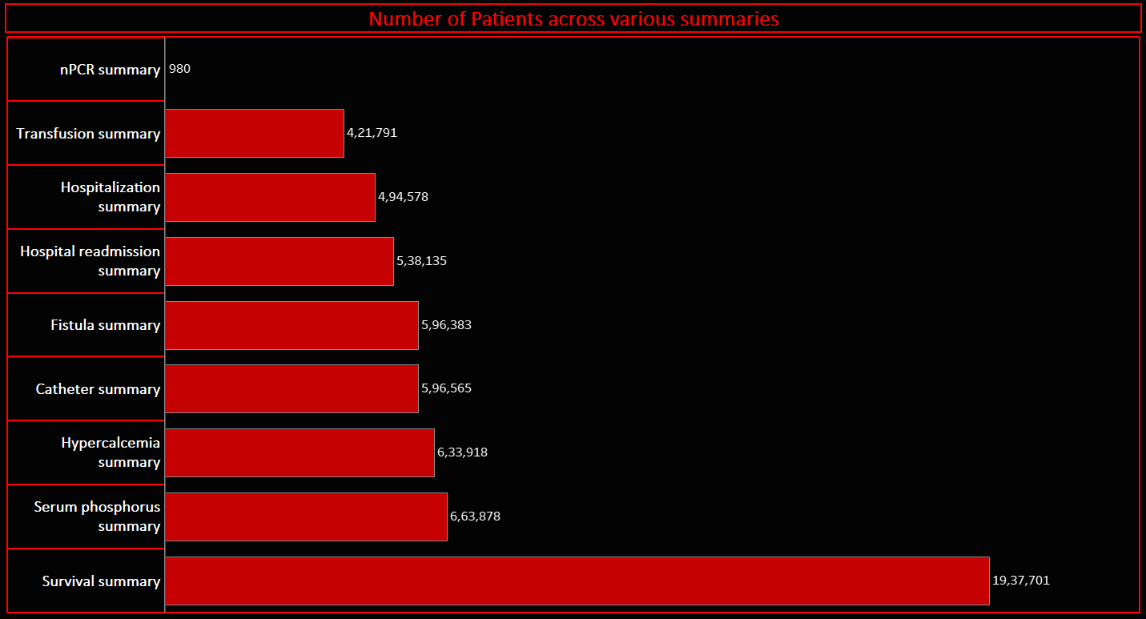
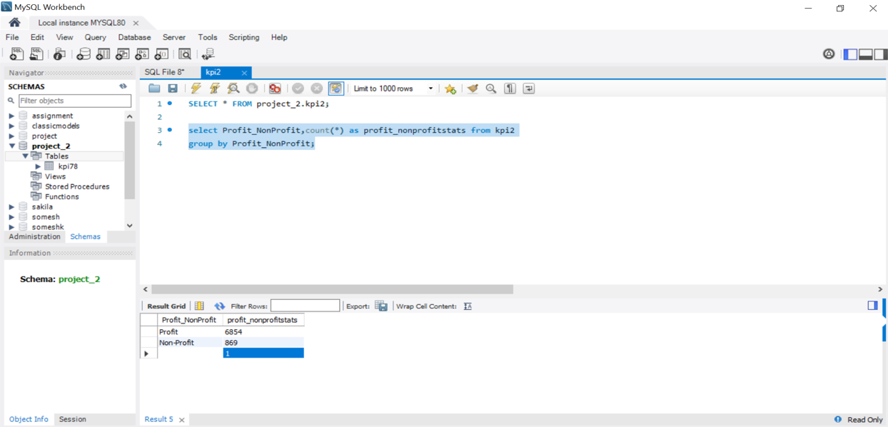
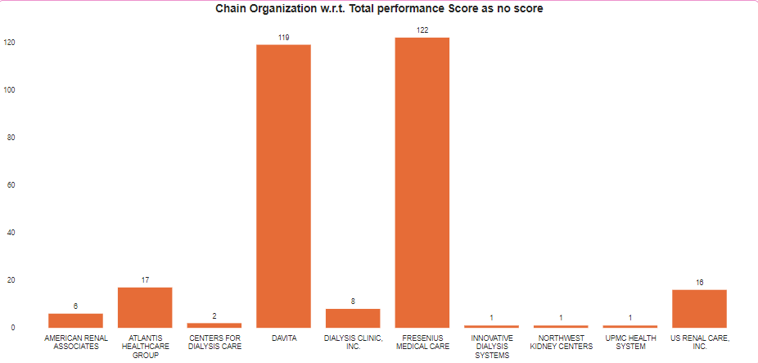
Highest number of patients are in survival summary
Least number of patients are in nPCR summary
Count of profit is 6854 which is 88.75%
Count of non profit is 869 which is 11.25%
Most numbers of no score performance are in ‘Fresenius medical care’ and ‘ Davita’ chain organization.
Total count of no score is 369.

Slide 5
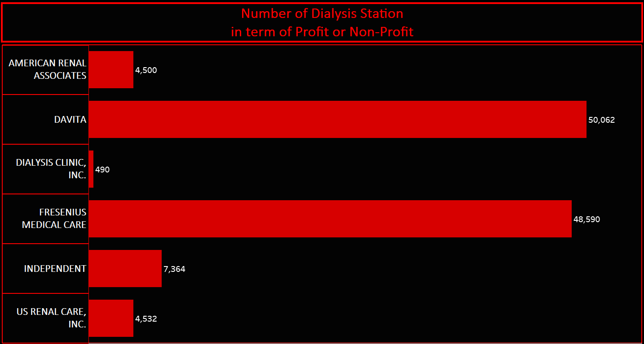
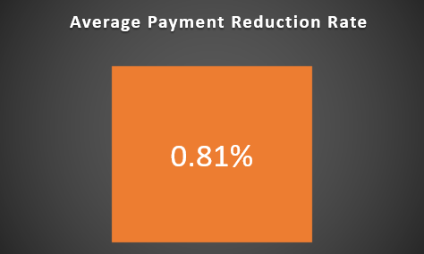
Total number of dialysis station is 55328
Davita has highest number of dialysis station in terms of Profit
Independent has highest number of dialysis station in terms of non profit
We had calculated the average payment reduction rate in percentage.

Slide 6
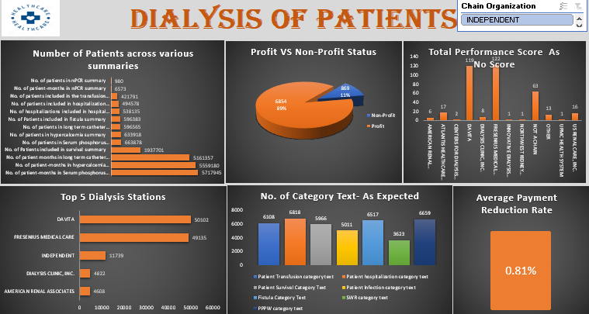
EXCEL DASHBOARD

Slide 7
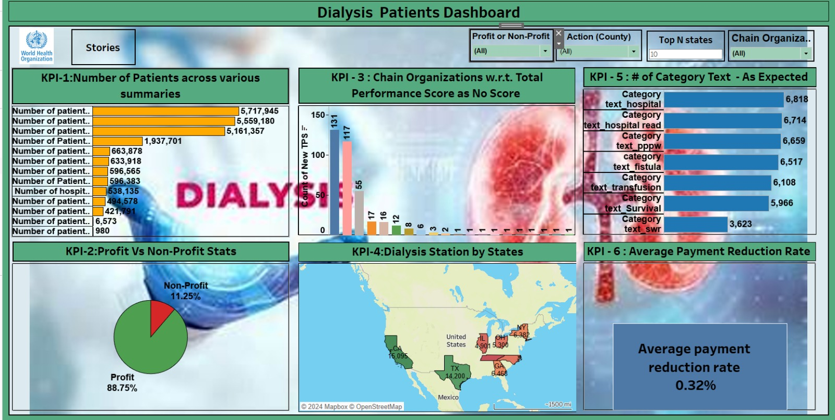
TABLEAU DASHBOARD

Slide 8
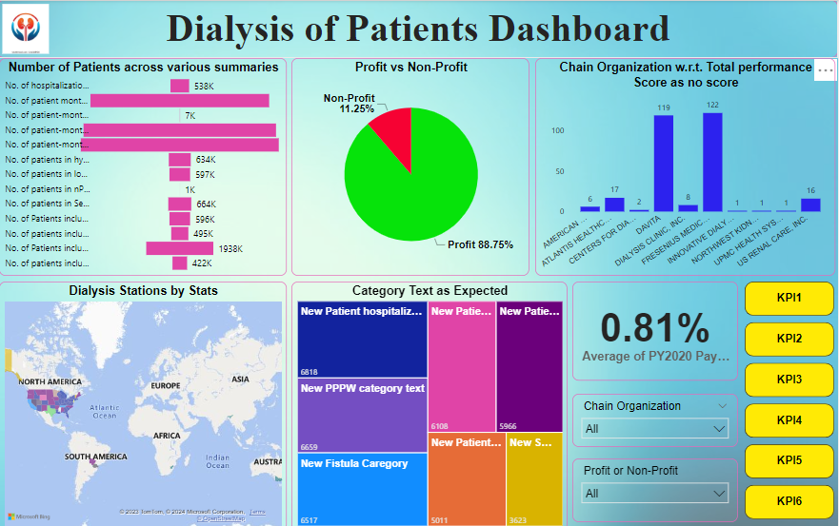
POWER-BI DASHBOARD

Slide 9
SUGGESTIONS
Focus on optimizing services for survival summary, given the highest number of patients in this category.
Continue optimizing profit-generating aspects, as they constitute the majority (88.75%) of patients.
Investigate and address performance issues in ‘Fresenius medical care’ and ‘Davita’ chain organizations.
Optimize resource allocation and services for Davita, as it has the highest number of dialysis stations in terms of profit.
Regularly monitor and manage the average payment reduction rate to ensure financial sustainability.

Slide 10
Conclusion
In summary, a comprehensive strategy that includes optimizing services for all patient summaries, addressing performance issues in specific chain organizations, and maximizing the potential of dialysis stations for both profit and non-profit segments will contribute to the overall success of the healthcare organization.

Slide 11
Thank you

